Slide 1
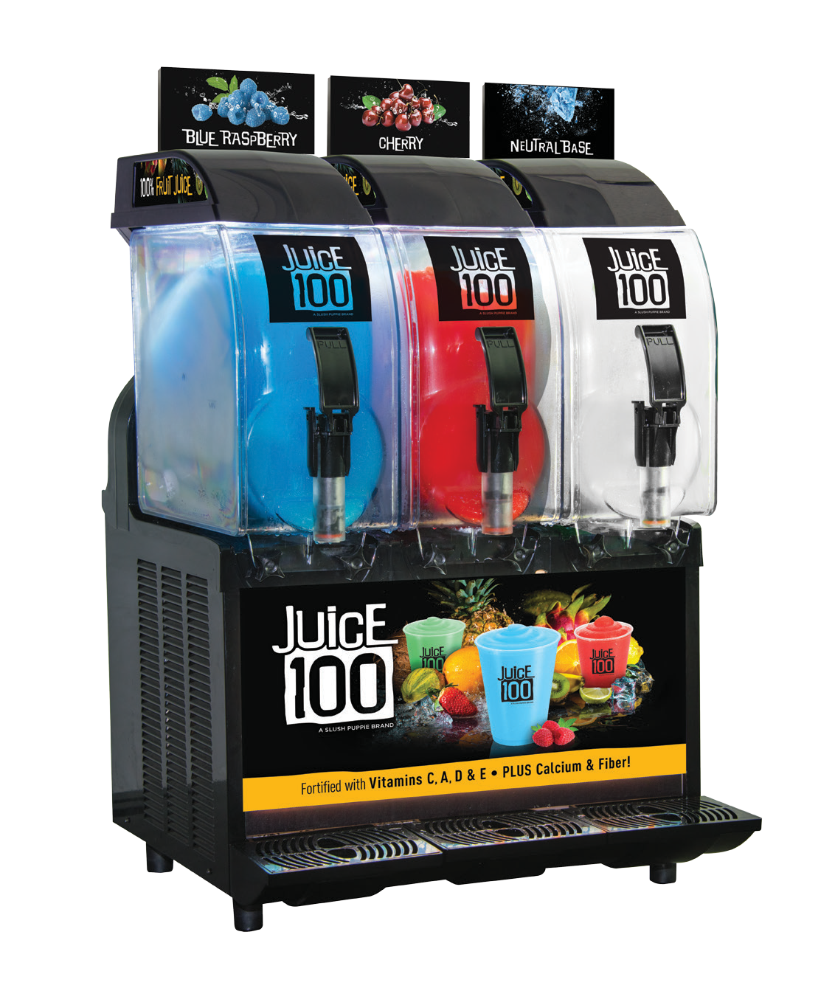
Product Features
100% Fruit Juice
No Added Sugars
100% Vitamin C DV
Fortified Vitamins A, D and E, Calcium, Potassium and Fiber
Fat-Free & Gluten-Free
Low-Calorie
Program Features
Smart Snack Approved
Qualifies for ½ Cup Fruit Reimbursable
Fully Branded Program – Equipment, Cups, Lids & Straws
Over a Dozen Bold and Innovative flavors
Cost-Effective vs. Other Fruit Options
Smoothies are Strong Item for A La Carte Sales
BRANDED EQUIPMENT: IPRO3
Simple Operation
No Waterlines Required. Just Mix and Pour.
Small Counter Footprint
110v Dedicated Circuit
1-800-543-0860 • www.SLUSHPUPPiE.com

Slide 2
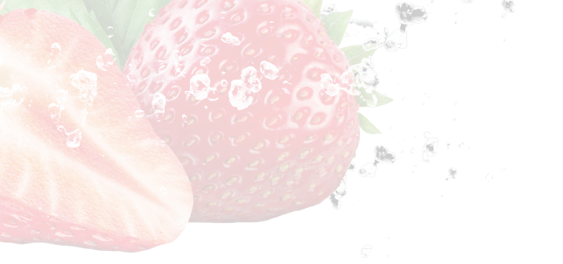
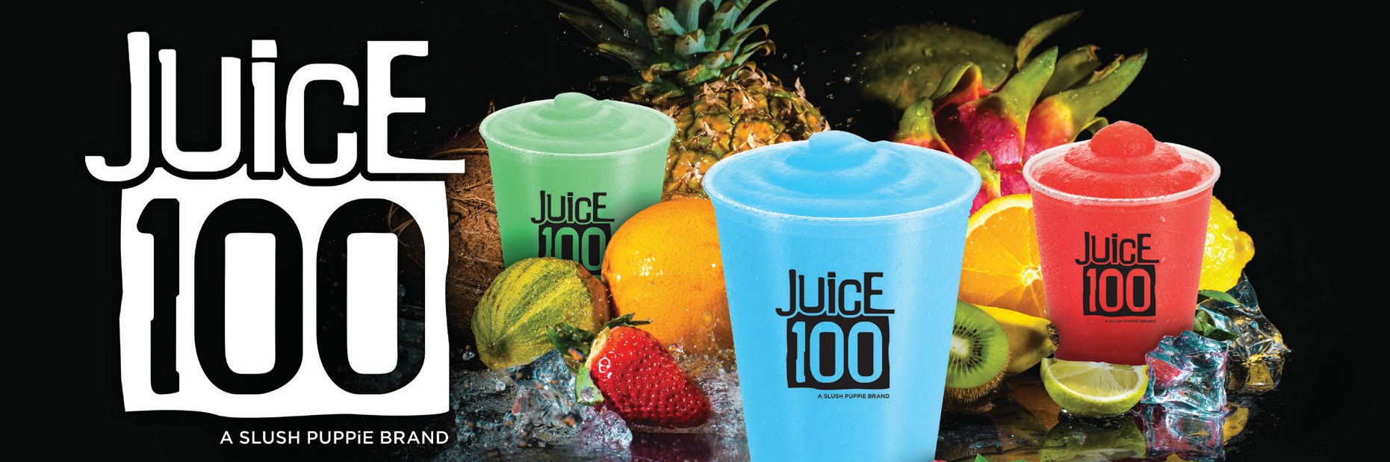
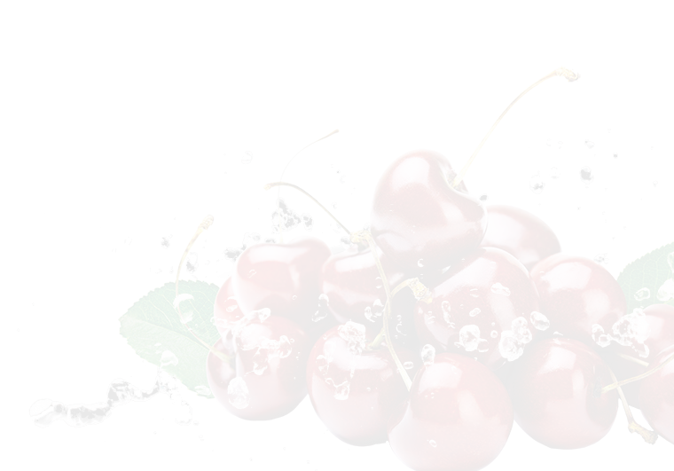



Product Description
Type
Case Pack
Mix Ratio
Case Yield Oz.
Juice100 CHERRY | BASE | 4x1 GAL CASE | 5+1 | 3072
Juice100 CHERRY | BASE | 5 GAL BIB | 5+1 | 3840
Juice100 BLUE RASPBERRY | BASE | 4x1 GAL CASE | 5+1 | 3072
Juice100 BLUE RASPBERRY | BASE | 5 GAL BIB | 5+1 | 3840
Juice100 KIWI STRAWBERRY | BASE | 4x1 GAL CASE | 5+1 | 3072
Juice100 STRAWBERRY LEMONADE | BASE | 4x1 GAL CASE | 5+1 | 3072
Juice100 MANGO | BASE | 4x1 GAL CASE | 5+1 | 3072
Juice100 DRAGON FRUIT | BASE | 4x1 GAL CASE | 5+1 | 3072
Juice100 STRAWBERRY MANGO | BASE | 4x1 GAL CASE | 5+1 | 3072
Juice100 NEUTRAL | BASE | 4x1 GAL CASE | 5+1 | 3072
Juice100 NEUTRAL | BASE | 5 GAL BIB | 5+1 | 3840
CHERRY | FLAVOR | 4x1 GAL CASE | Use W/ Neutral | n/a
WATERMELON | FLAVOR | 4x1 GAL CASE | Use W/ Neutral | n/a
POLAR PURPLE SHIVER | FLAVOR | 4x1 GAL CASE | Use W/ Neutral | n/a
BUBBLEGUM | FLAVOR | 4x1 GAL CASE | Use W/ Neutral | n/a
FROZEN ORANGE FRENZY | FLAVOR | 4x1 GAL CASE | Use W/ Neutral | n/a
LICIOUS LEMON LIMECICLE | FLAVOR | 4x1 GAL CASE | Use W/ Neutral | n/a
BLUE RASPBERRY | FLAVOR | 4x1 GAL CASE | Use W/ Neutral | n/a
STRAWBERRY | FLAVOR | 4x1 GAL CASE | Use W/ Neutral | n/a
SHOCKER ADDITIVE | FLAVOR | 4x1 GAL CASE | Use W/ Neutral | n/a
GREEN APPLE ICE CAP | FLAVOR | 4x1 GAL CASE | Use W/ Neutral | n/a
COTTON CANDY | FLAVOR | 4x1 GAL CASE | Use W/ Neutral | n/a
STRAWBERRY-KIWI | FLAVOR | 4x1 GAL CASE | Use W/ Neutral | n/a
DRAGON FRUIT | FLAVOR | 4x1 GAL CASE | Use W/ Neutral | n/a
STRAWBERRY MANGO | FLAVOR | 4x1 GAL CASE | Use W/ Neutral | n/a
Nutrition Facts
Serving Size 1.33 fl. oz concentrate (8 fl. oz diluted)
Amount Per Serving Calories 120 Calories from Fat 0
Total Fat 0 Saturated Fat 0 Trans Fat 0
Cholesterol 0
Sodium 40mg
Potassium 289mg Total Carbohydrate 30g Dietary Fiber 1g Total Sugars 28g
Added Sugars 0g
Other Carbs 1g
Protein 0
Vitamin A 10% DV • Vitamin C 100% DV Calcium 10% DV • Vitamin E 10% DV Iron 2% DV • Vitamin D 10% DV
*Percent Daily Values are based on a 2,000 calorie diet. Your Daily Values may be higher or lower depending on your calorie needs.
DRAGON FRUIT FLAVOR INGREDIENTS: Apple Juice Concentrate, White Grape Juice Concentrate, Coconut Water Concentrate, Water, Maltodextrin (fiber), Contains 2% or less of each of the following: Calcium Lactate, Citric Acid, Ascorbic Acid, Natural and Artificial
Flavors, Sodium Benzoate and Potassium Sorbate (preservatives), FD&C Red #40, Vitamin E, Vitamin A, Vitamin D, FD&C Blue #1.
MANGO STRAWBERRY FLAVOR INGREDIENTS: Apple Juice Concentrate, White Grape Juice Concentrate, Coconut Water Concentrate, Water, Maltodextrin (fiber), Contains 2% or less of each of the following: Calcium Lactate, Citric Acid, Ascorbic Acid, Natural and Artificial Flavors, Sodium Benzoate and Potassium Sorbate (preservatives), FD&C Yellow #6, FD&C Red #40, Vitamin E, Vitamin A and Vitamin D.
BLUE RASPBERRY FLAVOR INGREDIENTS: Apple Juice Concentrate, White Grape Juice Concentrate, Coconut Water Concentrate, Water, Maltodextrin (fiber), Contains 2% or less of each of the following: Calcium Lactate, Citric Acid, Ascorbic Acid, Natural and Artificial Flavors, Sodium Benzoate and Potassium Sorbate (preservatives), FD&C Blue #1, Vitamin E, Vitamin A and Vitamin D.
CHERRY FLAVOR INGREDIENTS: Apple Juice Concentrate, White Grape Juice Concentrate, Coconut Water Concentrate, Water, Maltodextrin (fiber), Contains 2% or less of each of the following: Calcium Lactate, Citric Acid, Ascorbic Acid, Natural and Artificial Flavors, Sodium Benzoate and Potassium Sorbate (preservatives), FD&C Red #40, Vitamin E, Vitamin A and Vitamin D.
MANGO FLAVOR INGREDIENTS: Apple Juice Concentrate, White Grape Juice Concentrate, Coconut Water Concentrate, Water, Maltodextrin (fiber), Contains 2% or less of each of the following: Calcium Lactate, Citric Acid, Ascorbic Acid, Natural and Artificial Flavors, Sodium Benzoate and Potassium Sorbate (preservatives), FD&C Yellow #5, FD&C Yellow #6, Vitamin E, Vitamin A and Vitamin D.
NEUTRAL BASE FLAVOR INGREDIENTS: Apple Juice Concentrate, White Grape Juice Concentrate, Coconut Water Concentrate, Water, Maltodextrin (fiber), Contains 2% or less of each of the following: Calcium Lactate, Ascorbic Acid, Citric Acid, Sodium Benzoate and Potassium Sorbate (preservatives), Vitamin E, Vitamin A and Vitamin D.
1-800-543-0860 • www.SLUSHPUPPiE.com

