Slide 1
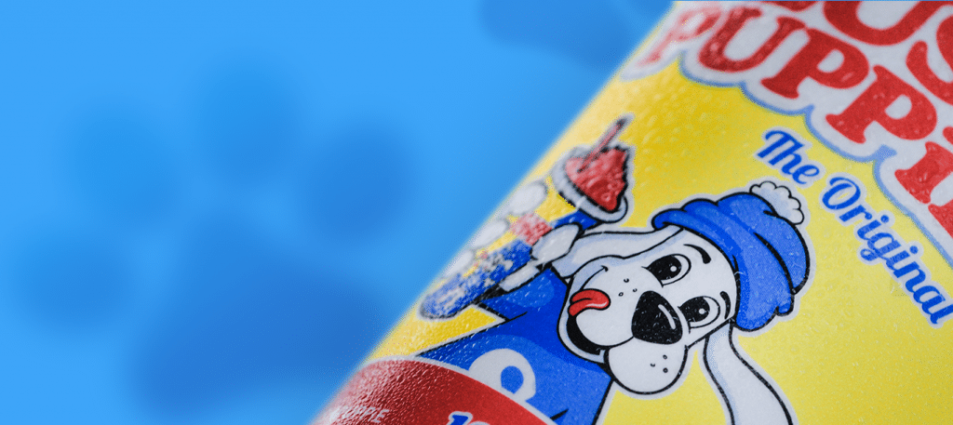
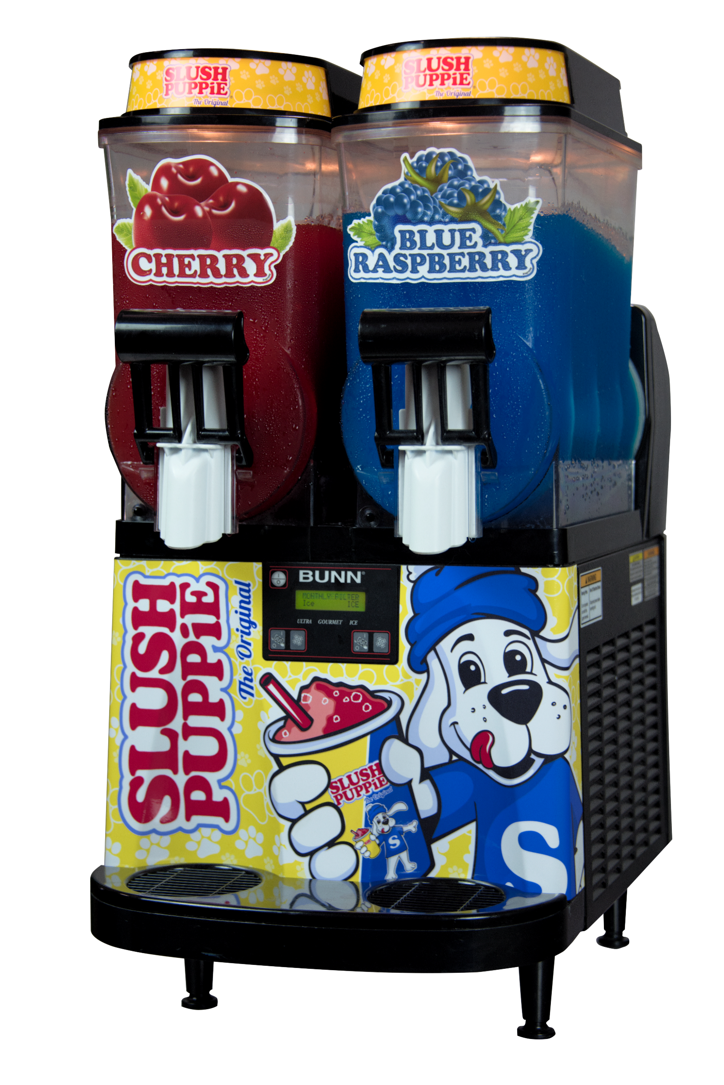
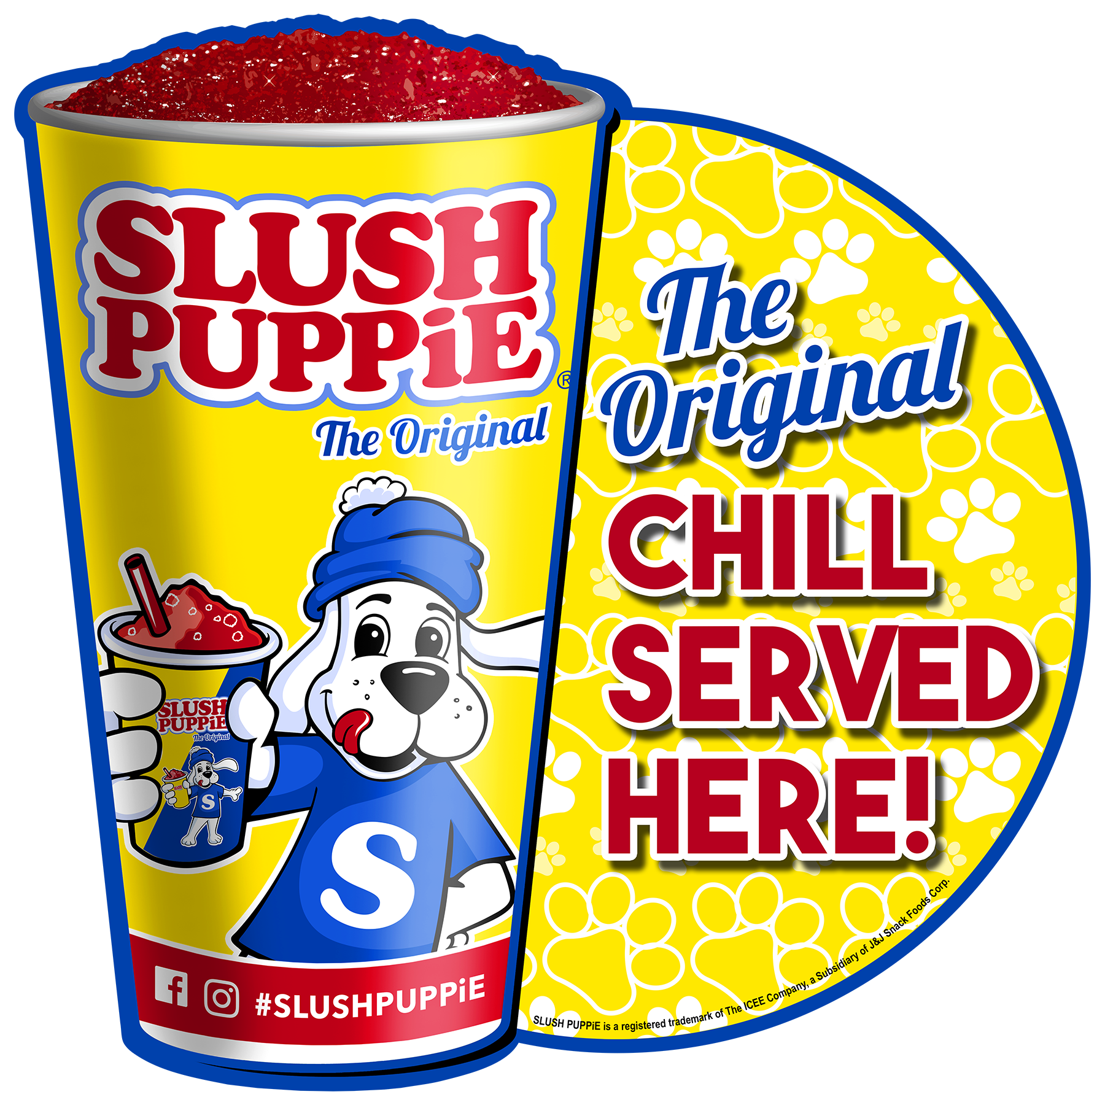
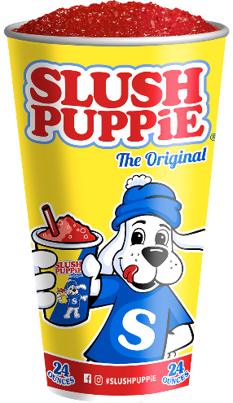
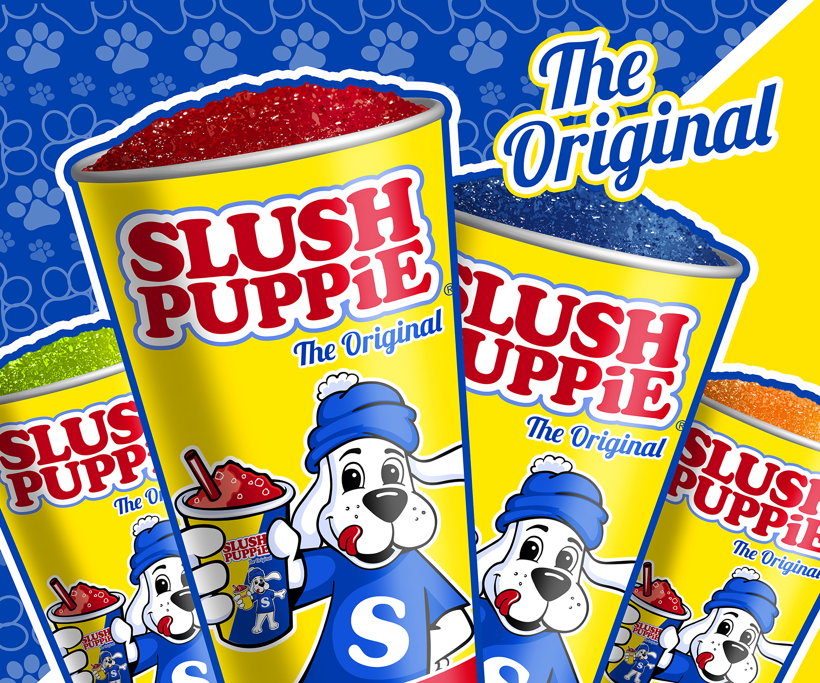
Starter Kit
$2,495
Freight & Install Included
Attract More Customers
SLUSH PUPPiE provides retailers a unique product and a beloved, iconic brand that helps transform stores into destination locations that consumers hunt down and seek out.
SLUSH PUPPiE attracts new, loyal and repeat customers who increase retailer’s customer base resulting in increased sales across all categories.
Branded Program Sells More
We include a full point of sale graphics kit to
compel consumers to purchase.
Kit includes: hanging mobile sign, window cling sign, pricing easel, flavor decals
Our branded cups help anchor the program & drive consumers back to your location!

Slide 2
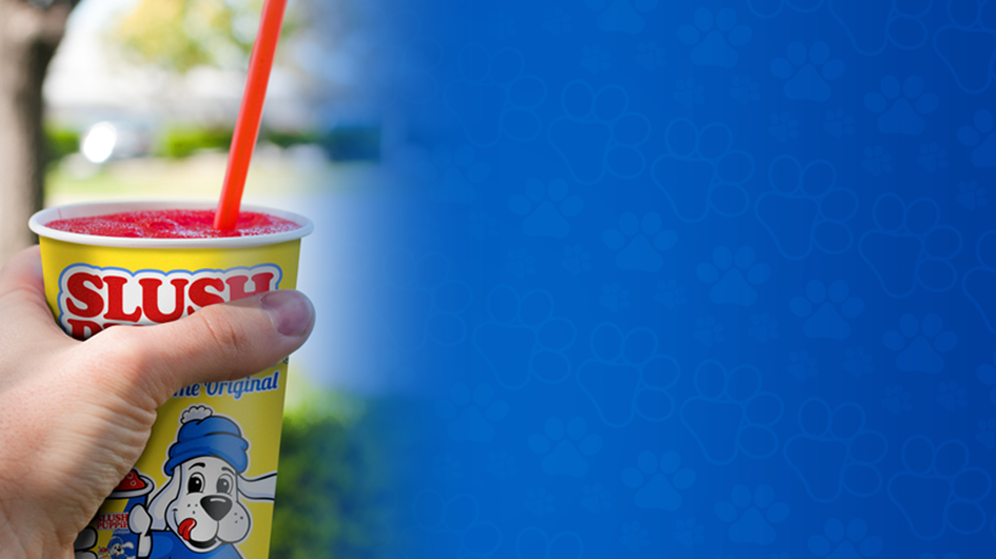
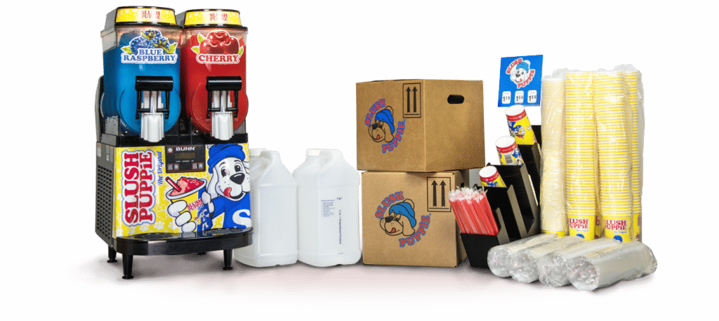
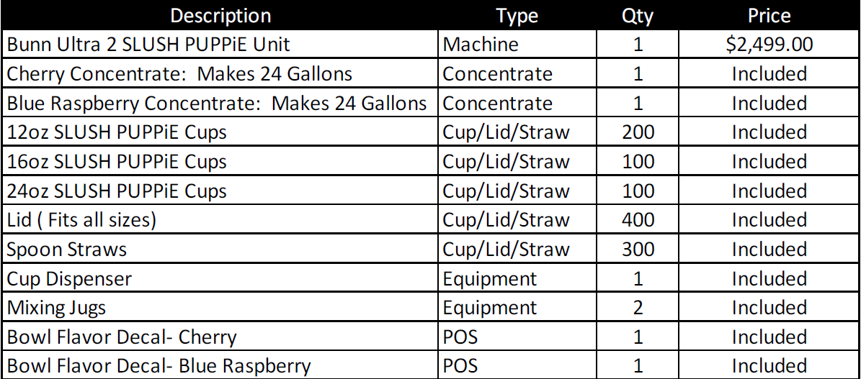
Starter Kit Components
Starter Kit Components
Sell the 400 drinks included in your kit and make up to $900! Making your Net Investment Less than $1,600!

Slide 3
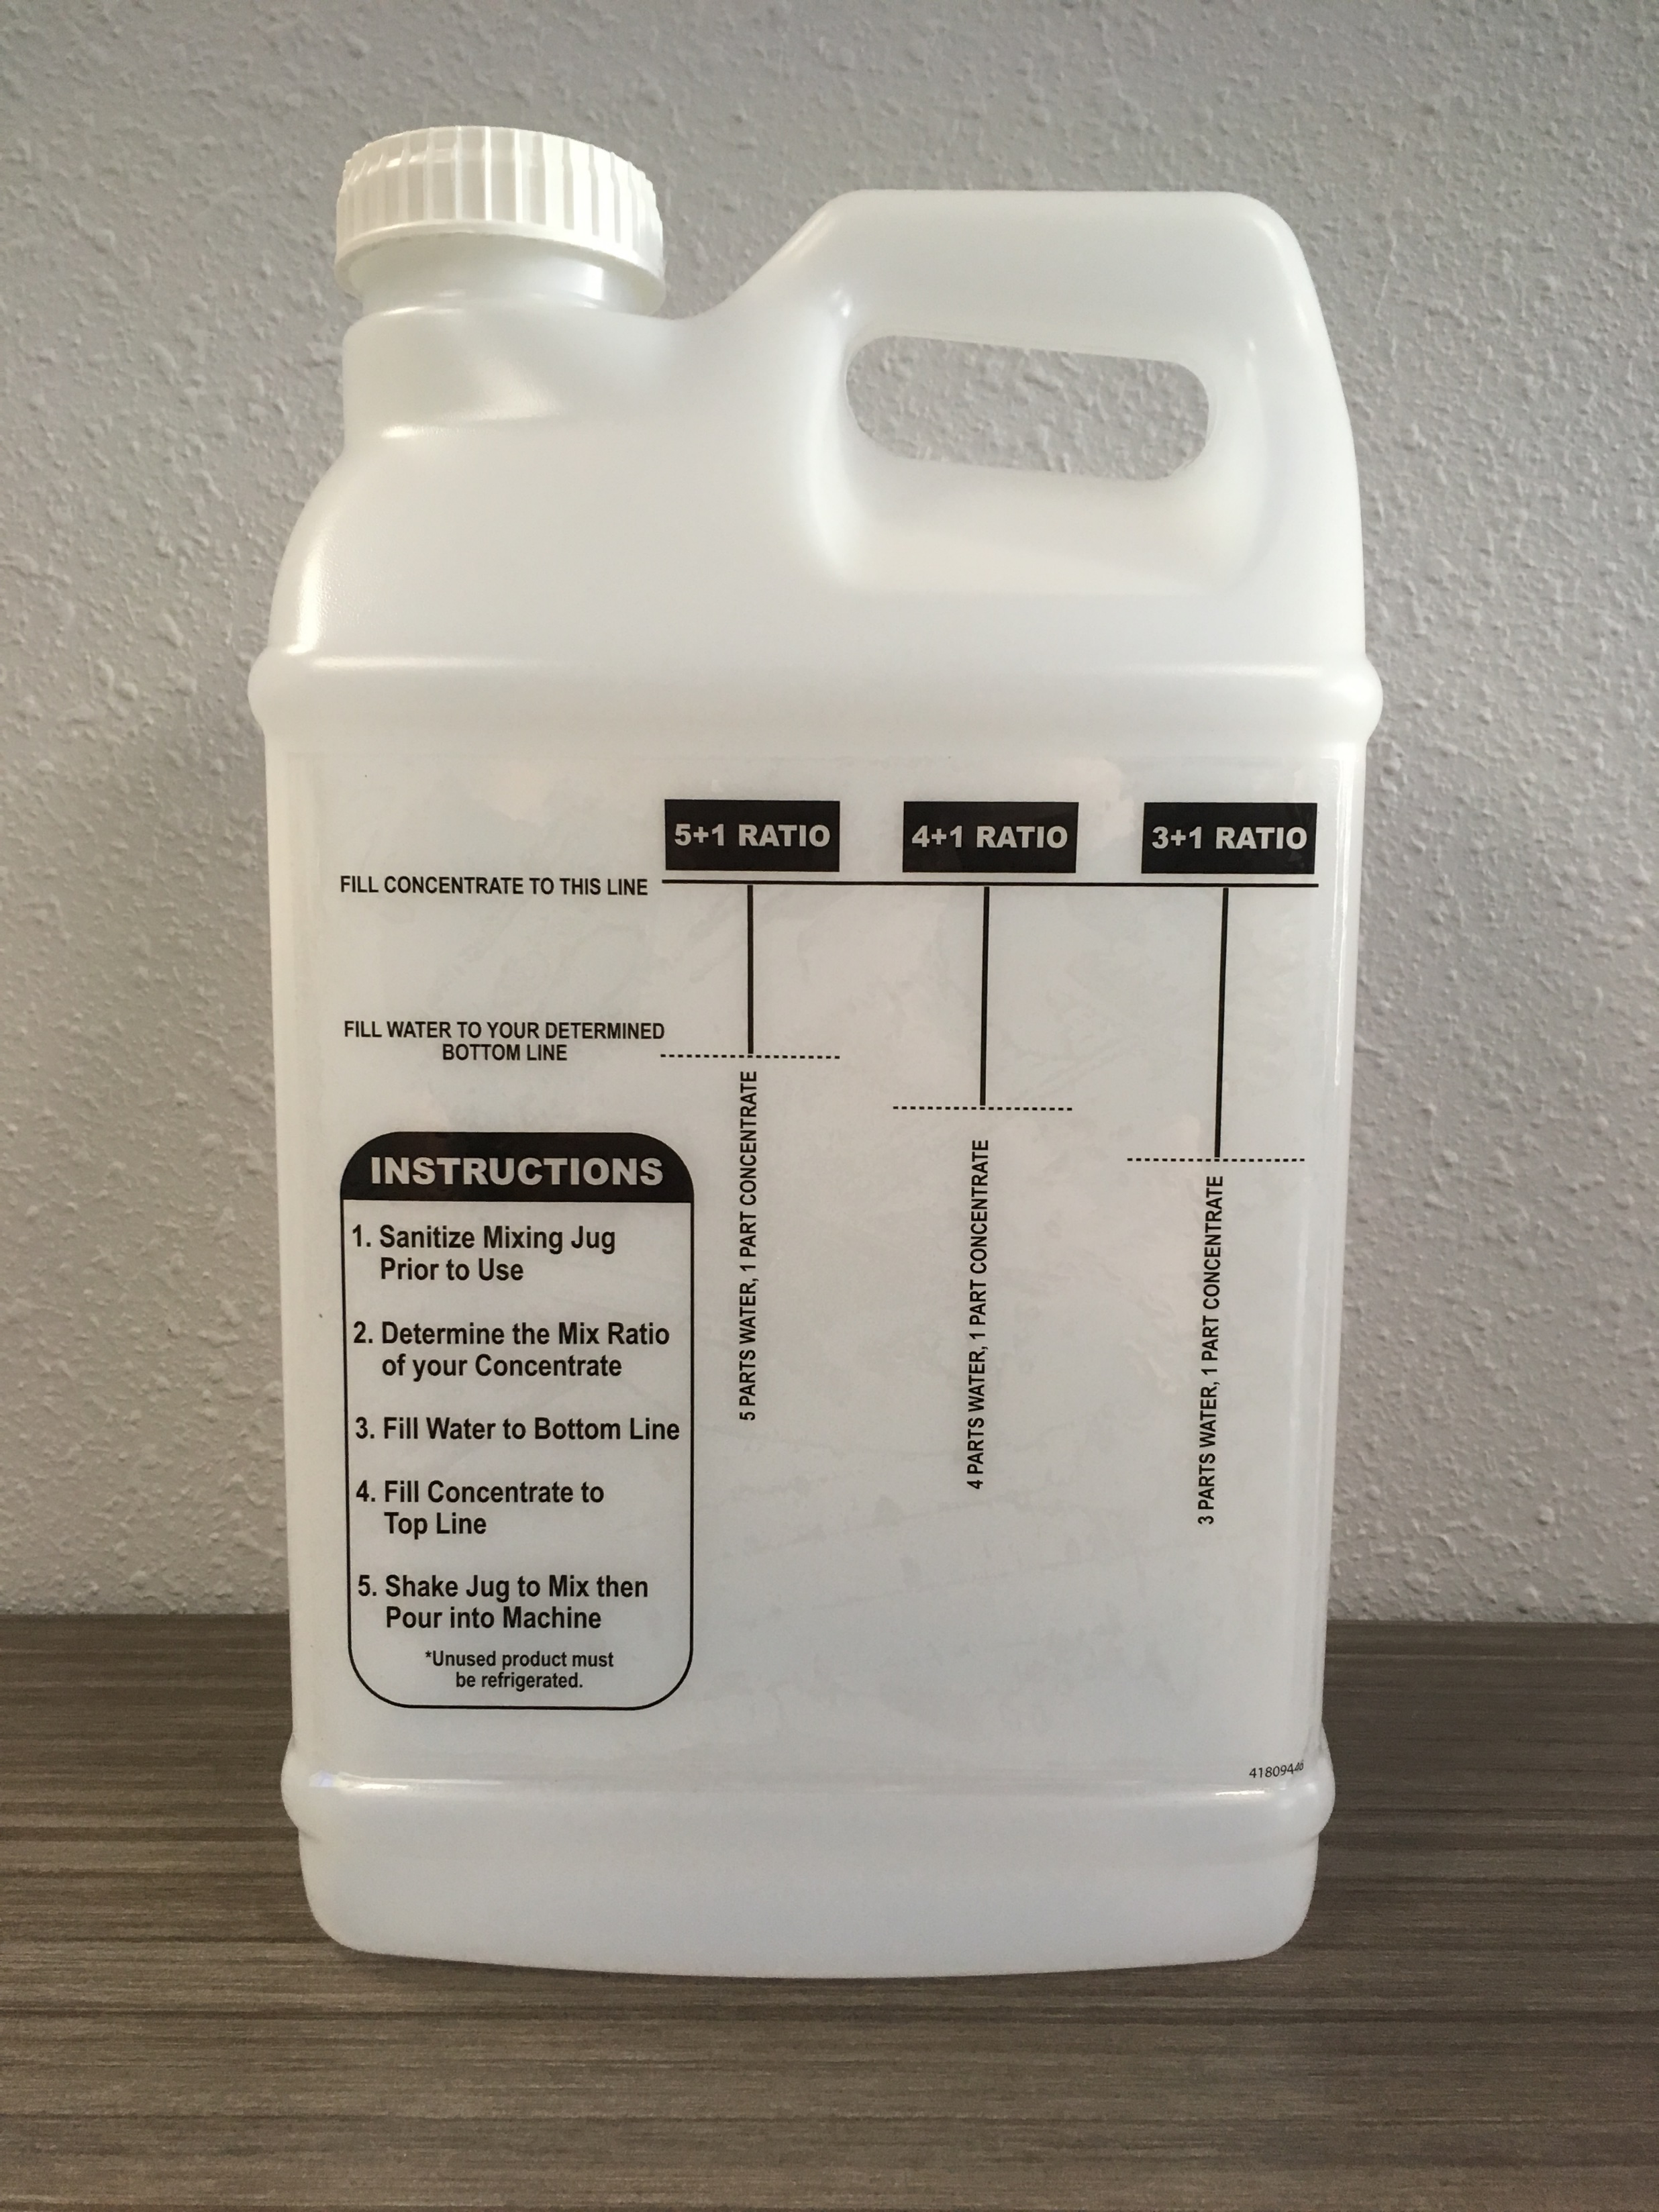
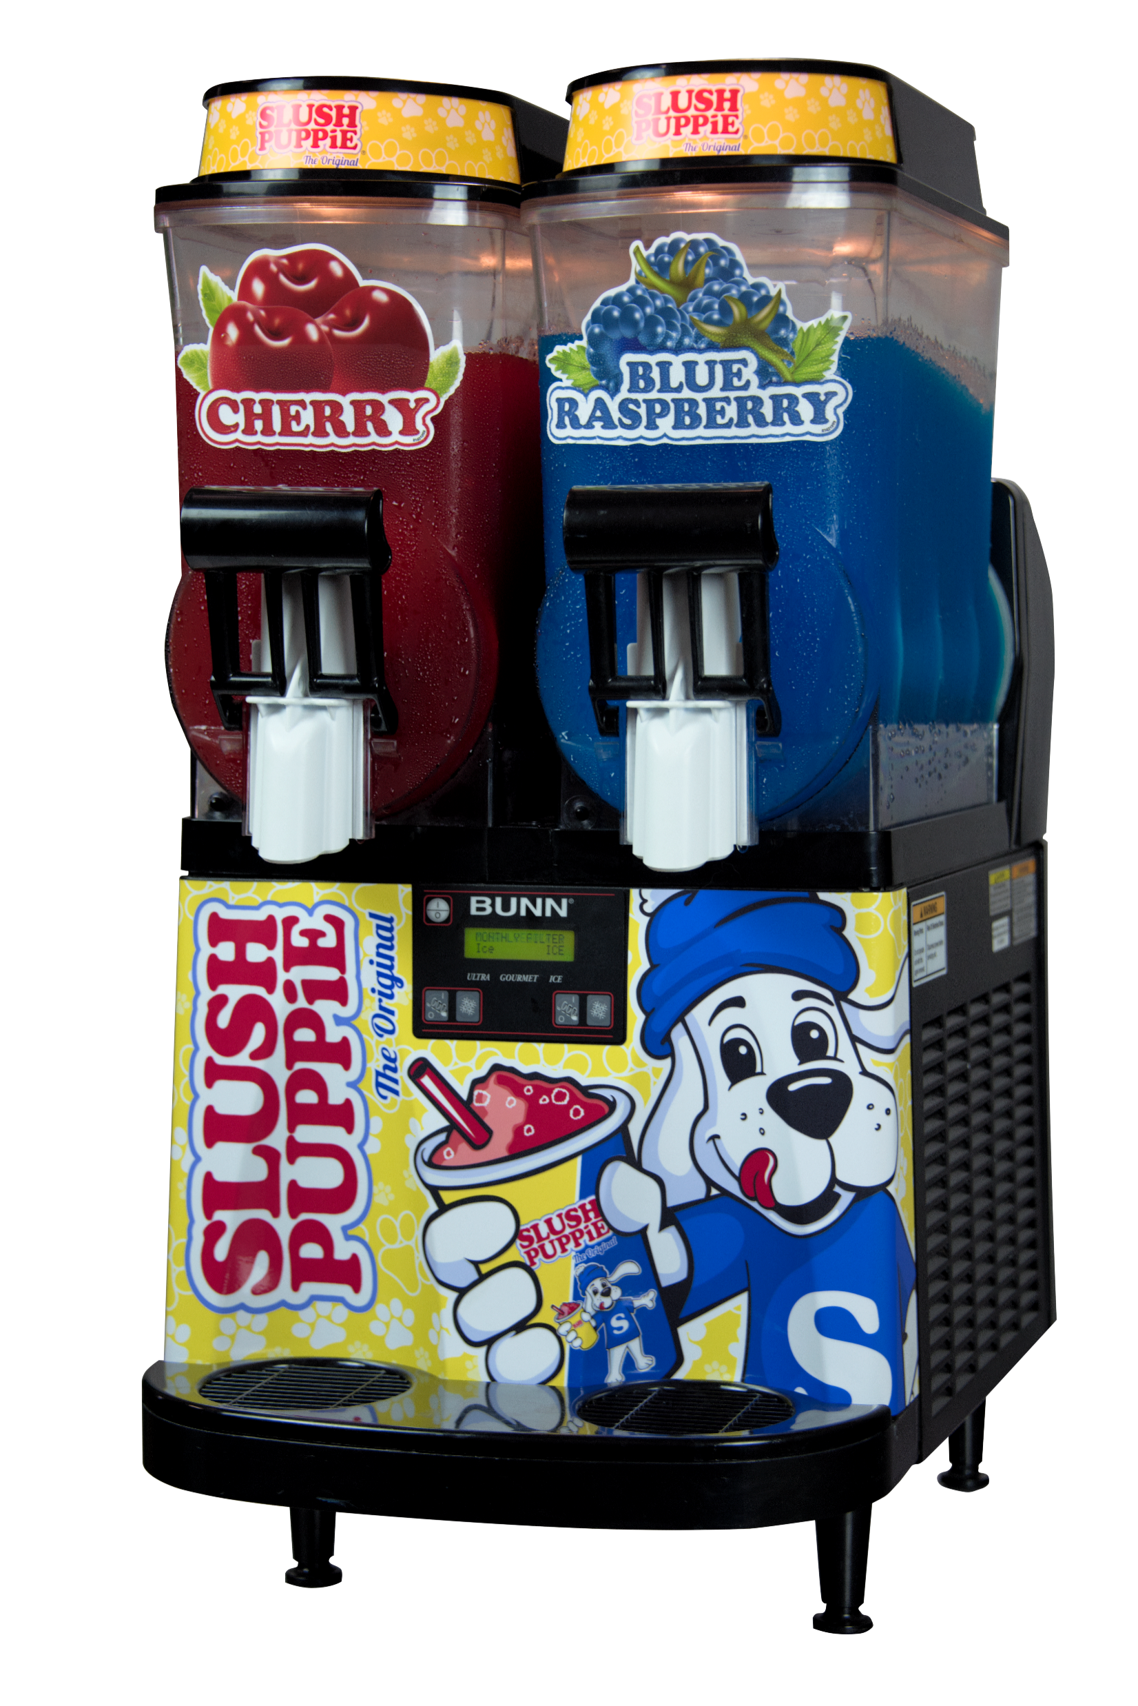
Simple Product Preparation
Mixing Jugs are provided. Mixing Directions:
Sanitize Mixing Jug
Locate the mix ratio on your SLUSH PUPPiE Concentrate. Most are 5 Parts Water + 1 Part Concentrate.
Locate the matching mix ratio guide on the mixing jug.
Fill mixing jug with water to the bottom line
Top off mixing jug with concentrate to the top line.
Shake gently and add to SLUSH machine
Mix additional product and store in refrigerator for machine refills.
Bunn Ultra 2 Machine
Industry Leading Warranty!
Simple Operation
Small Footprint
No Water Lines
No Drain Required
110V (Dedicated Circuit)
Energy Efficient with Night Mode
Bowls and seals are easily removed for cleaning and sanitation. Refer to your machine manual for simple to follow directions!
*Machine warranty subject to change by manufacturer
Machine Specifications
Height: 31.9"
Width: 16"
Depth: 24.5"
Weight: 137 lbs.
Cooling: Air
Refrigerant: 404A
Electrical: 115VAC 60 HZ 1 PH 15A Dedicated Circuit
Compressor HP: 3/4
Capacity: 6 gal. (3 gal. per bowl)
*specification subject to change at any time without notification

