Slide 1
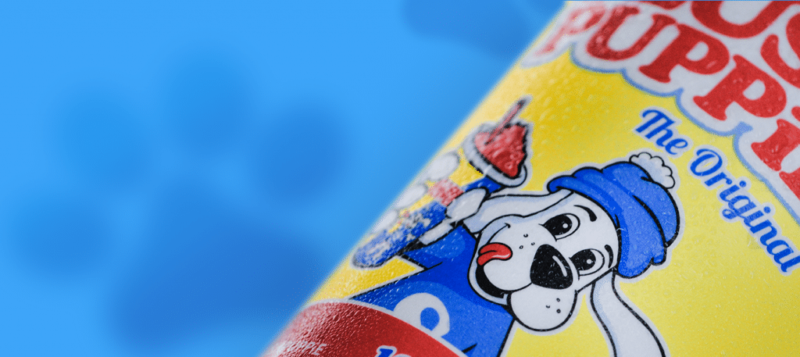
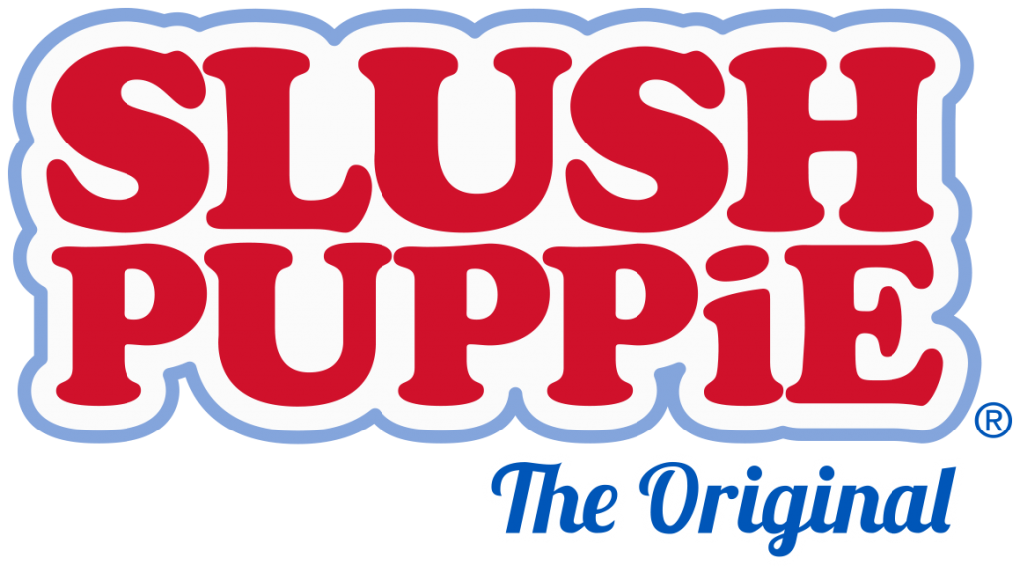
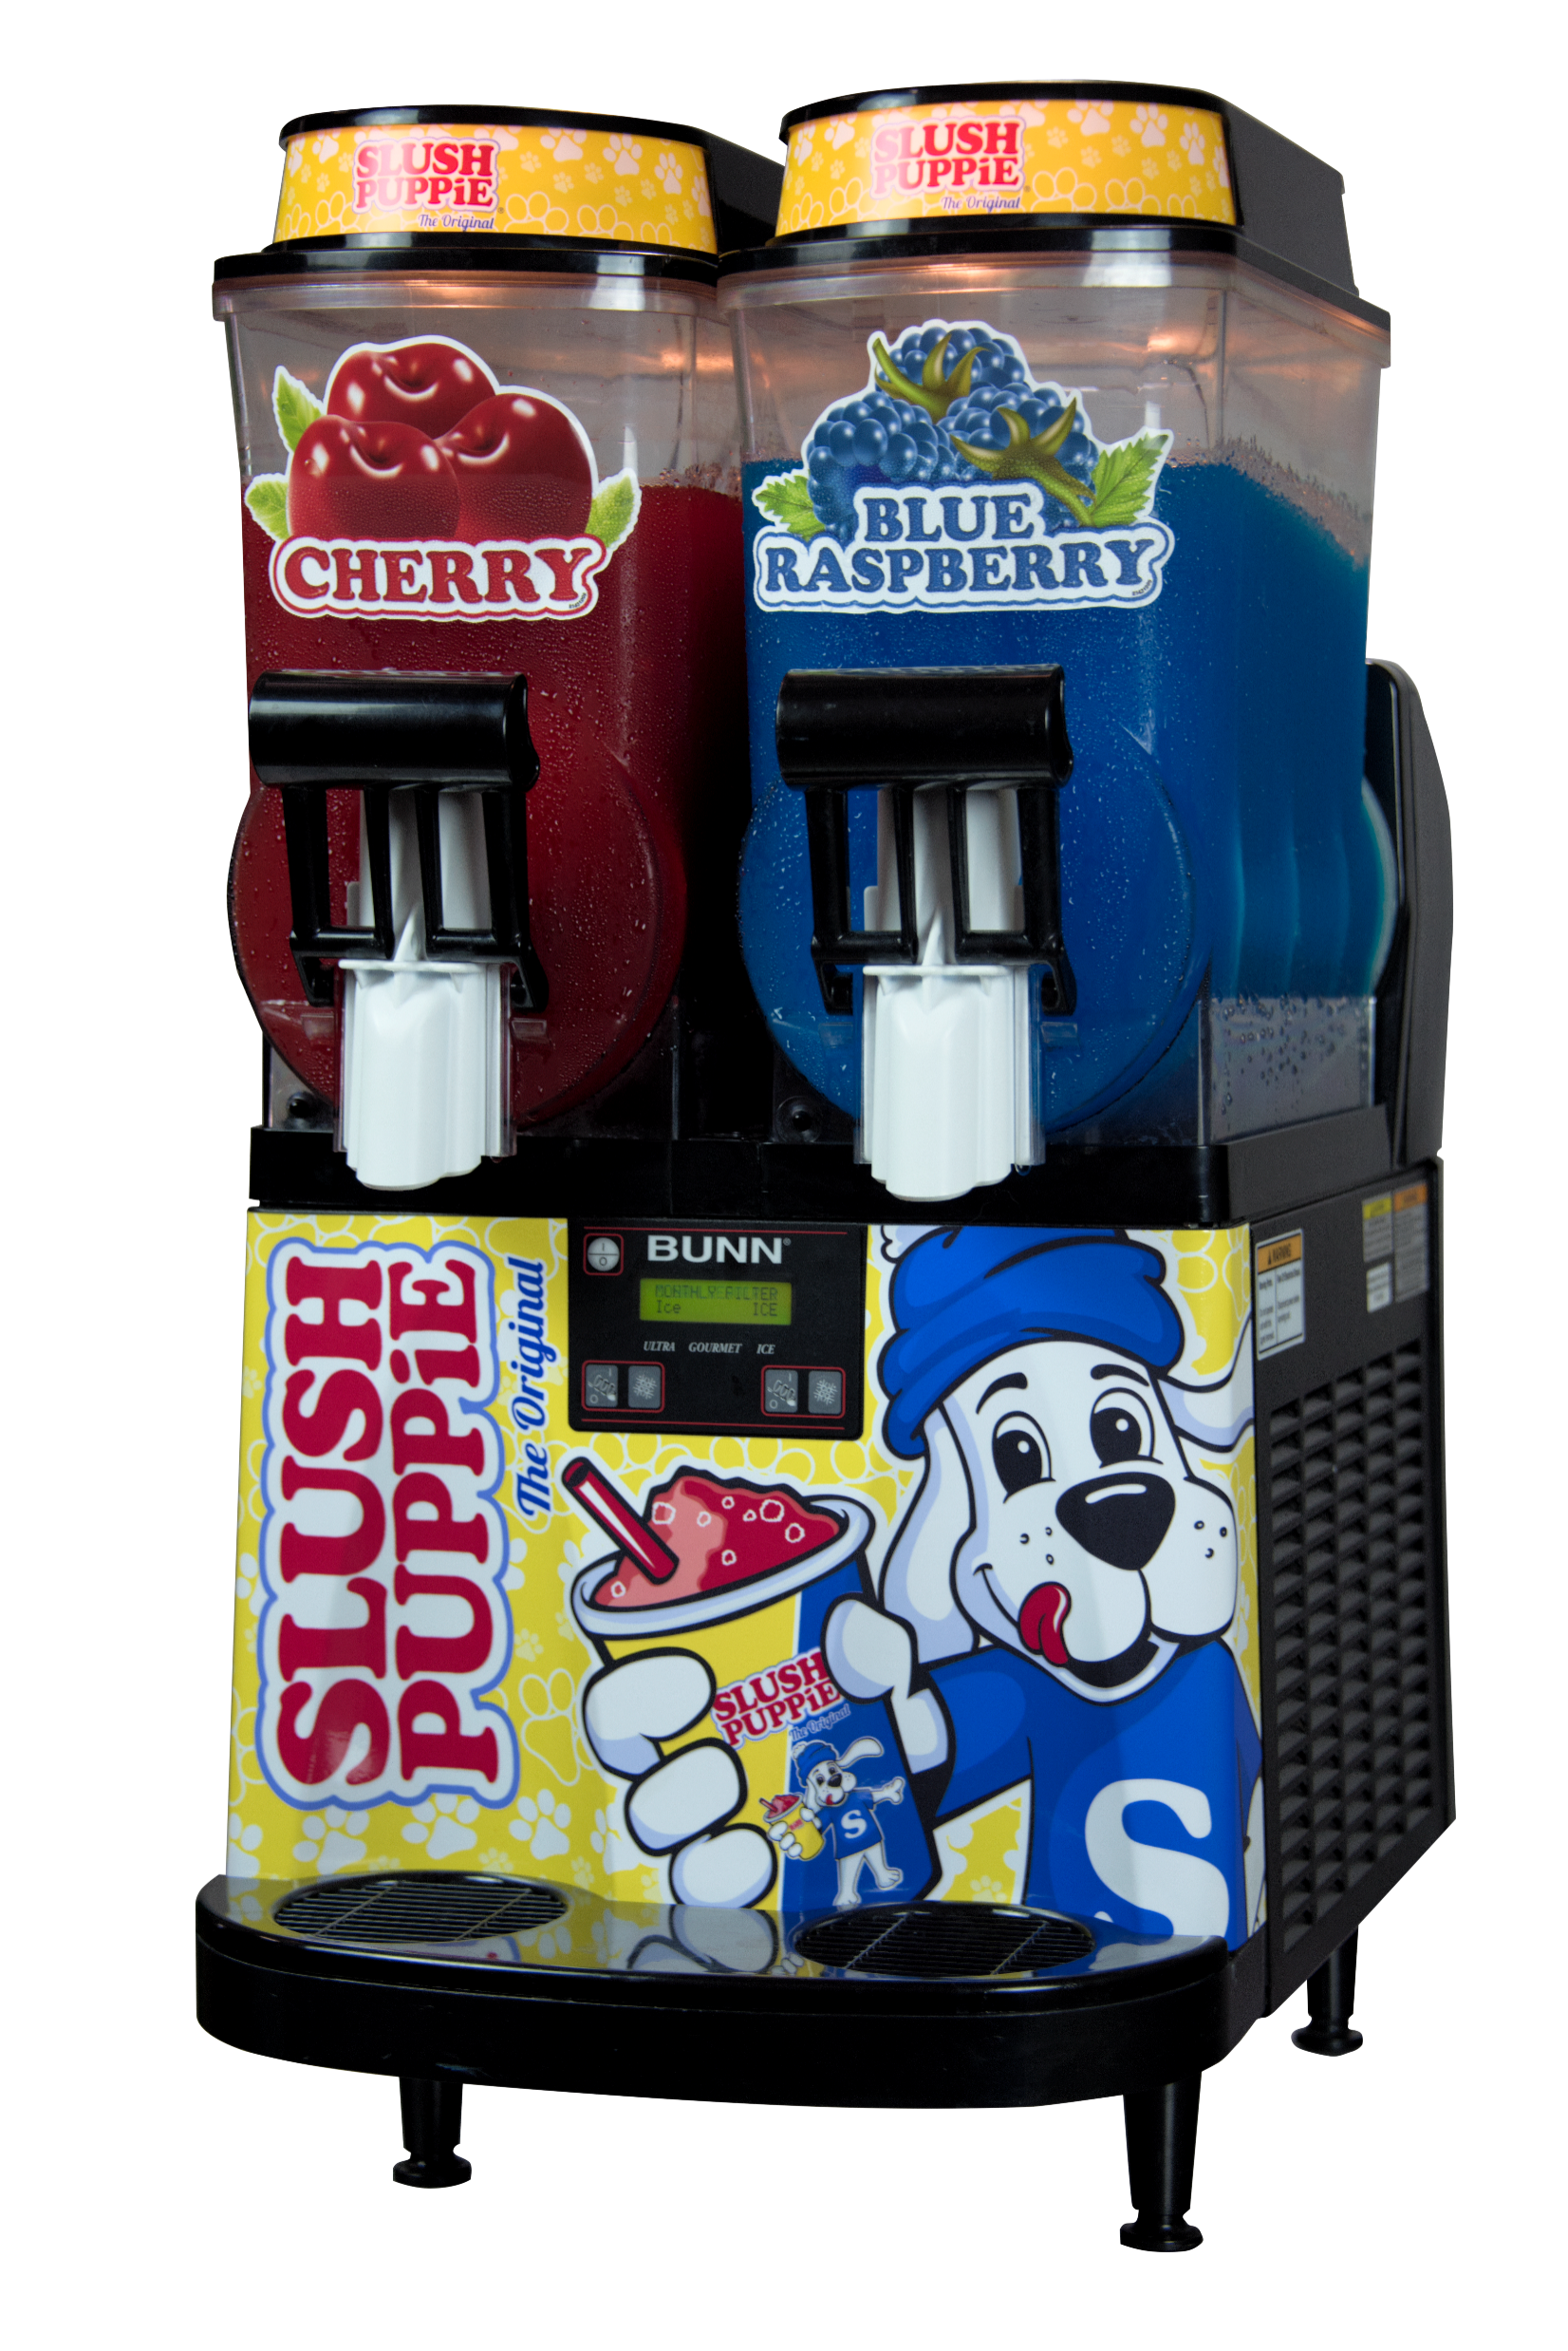
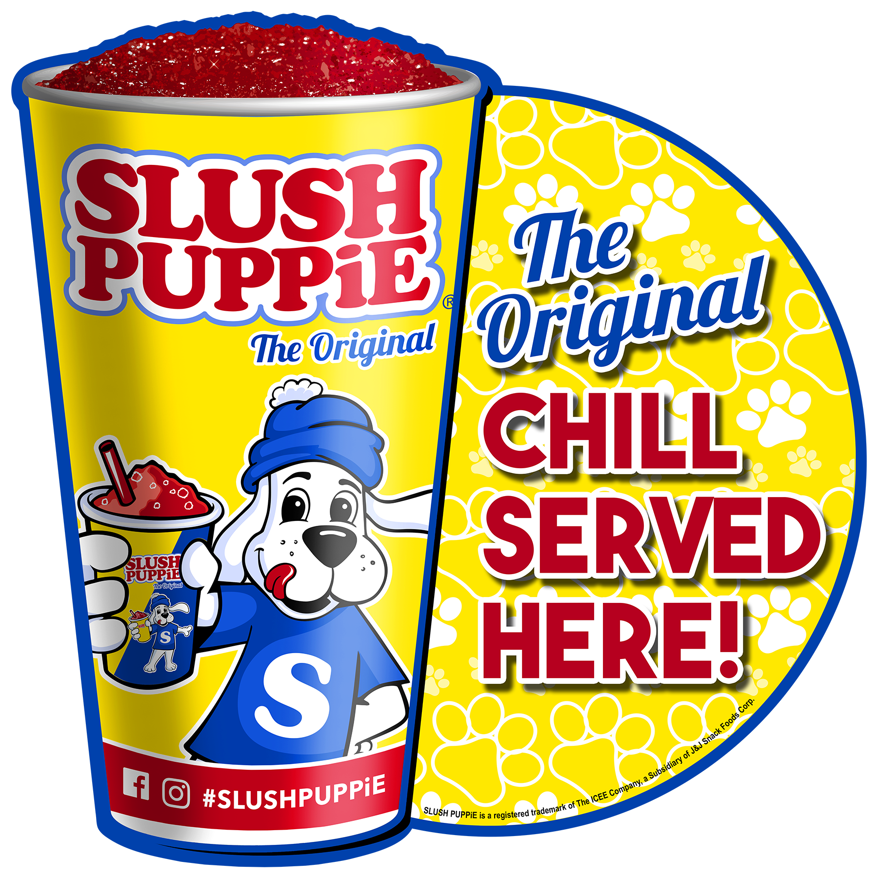
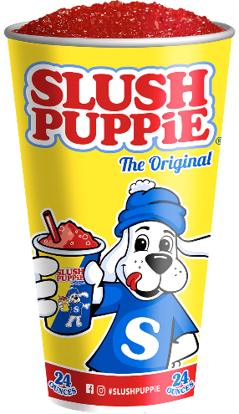
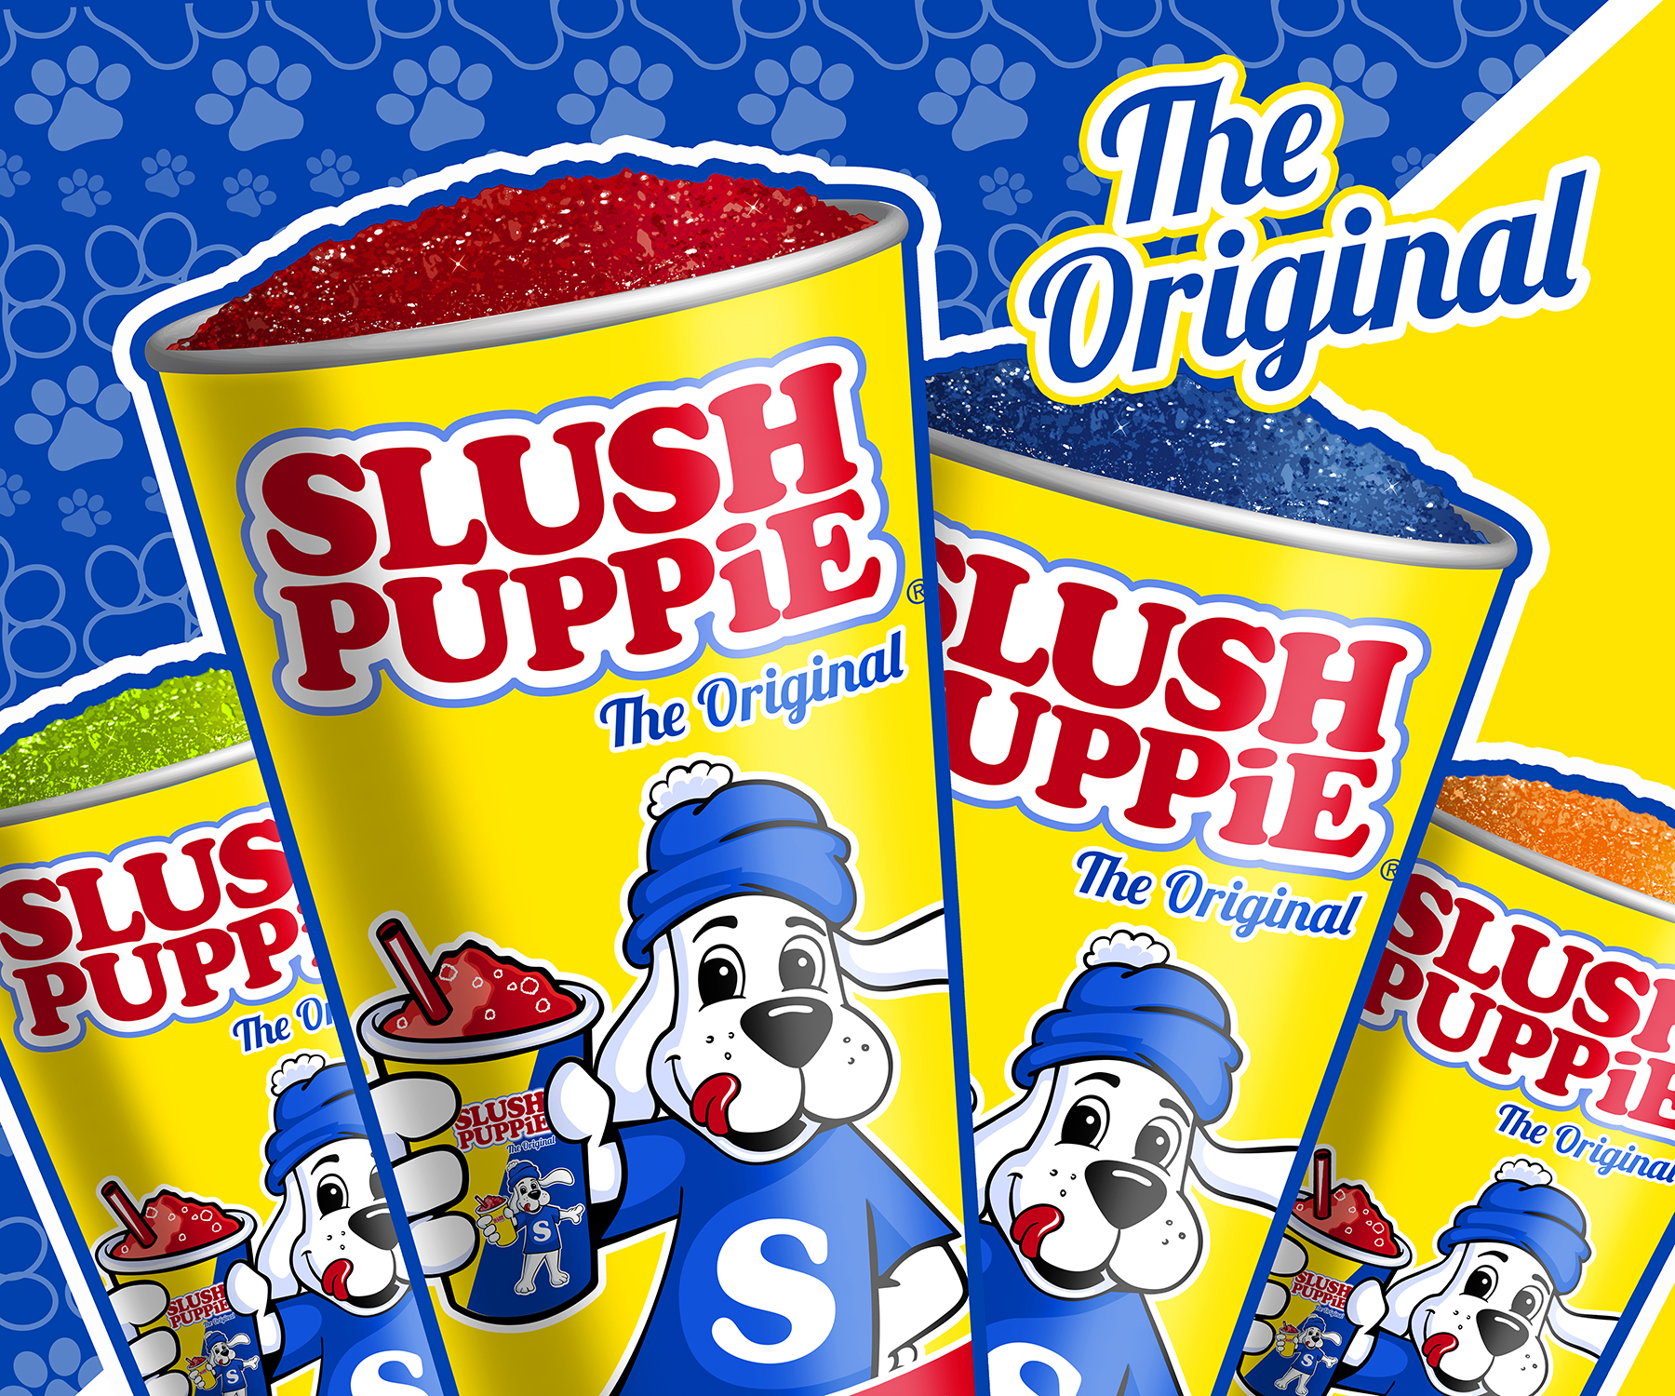
No Equipment Purchase Required!
FREE Maintenance Included
Attract More Customers
SLUSH PUPPiE provides retailers a unique product and a beloved, iconic brand that helps transform stores into destination locations that consumers hunt down and seek out.
SLUSH PUPPiE attracts new, loyal and repeat customers who increase retailer’s customer base resulting in increased sales across all categories.
Branded Program Sells More
We include a full point of sale graphics kit to
compel consumers to purchase.
Kit includes hanging mobile sign, window cling sign, outdoor sign
Our branded cups help anchor the program & drive consumers back to your location!

Slide 2
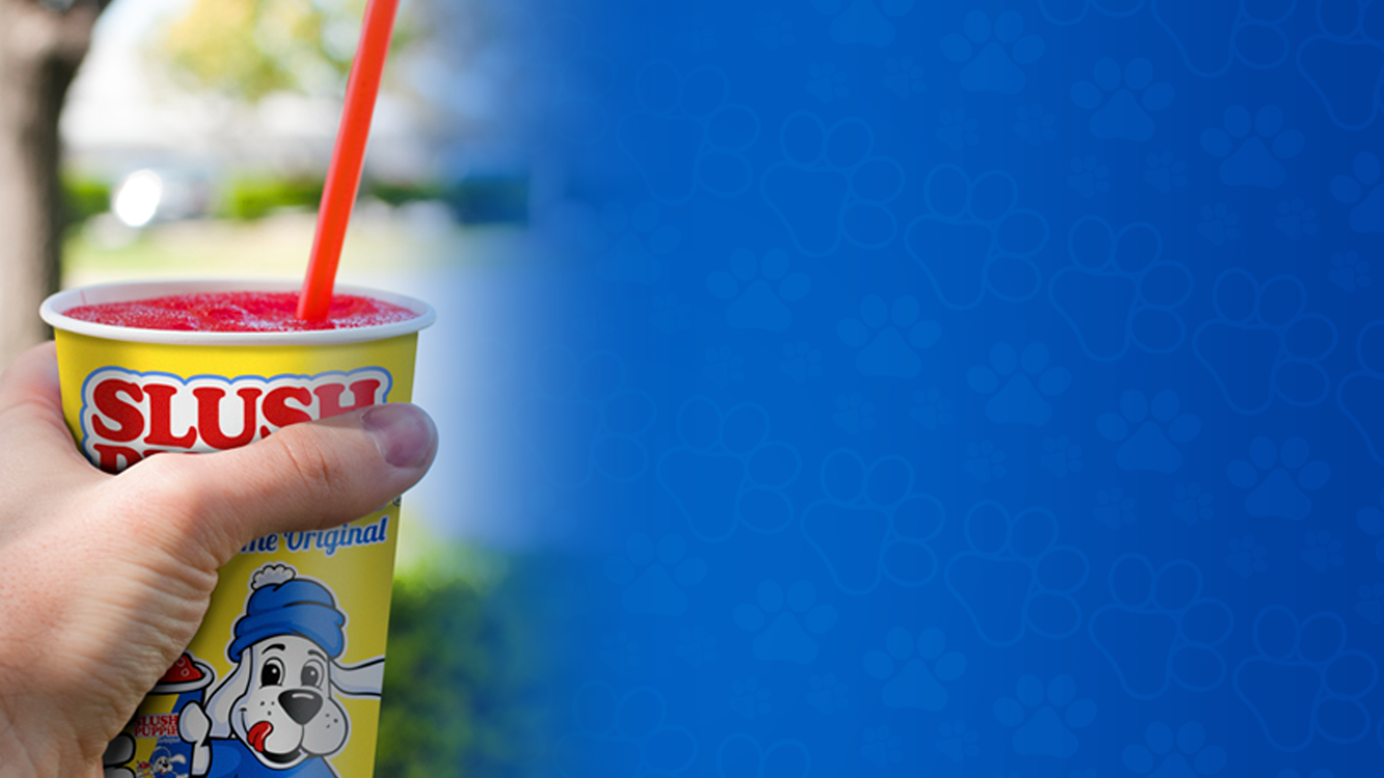
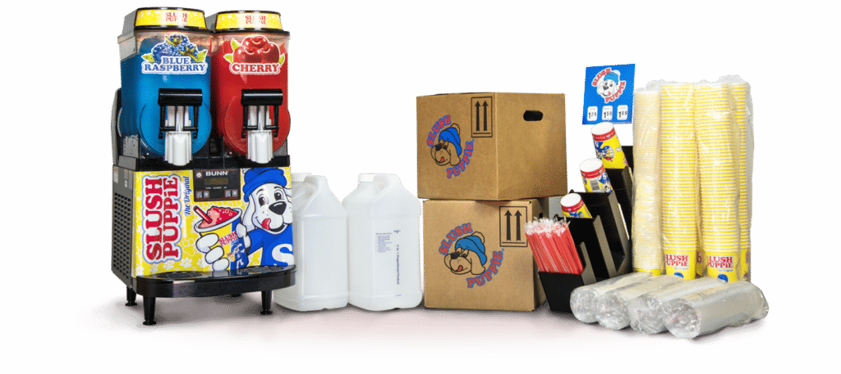
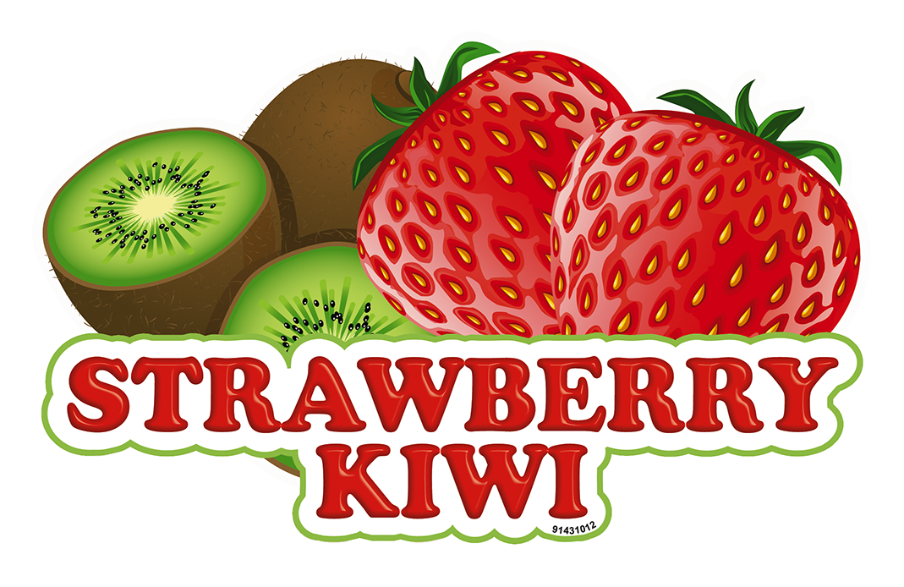
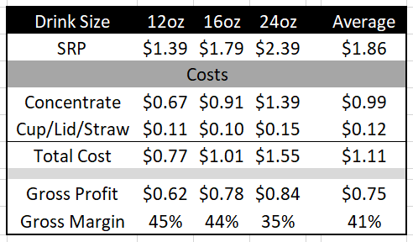
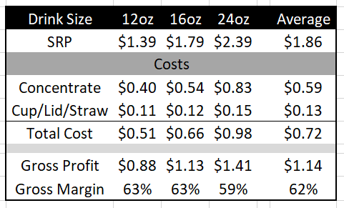
SLUSH PUPPiE Starter Kit
Everything you need to get started!
Concentrates Available
Upcharge Program
(Loaned Machine)
Customer Owned Machine Program
41% GM
62% GM

